Slide 1
How To Apply to Graduate School
A presentation by Heena Gandevia & Anjali Pandey

Slide 2
DISCLAIMER: We have not gotten into grad school yet. All opinions are our own, and have not been approved by any body. We think we’re smart, and we could be right. Probably, but maybe not. All information has been obtained by our own research, so we’re like 82.7% reliable

Slide 3
The Full Package
Research Experience
A whole lot of planning
Letters of Recommendation
Personal Statement
GRE’s
Resume
Publications
Poster Presentations
Applications
Interviews

Slide 4
1. Research Experience
At least 2 years of research experience (the more the merrier)
At the latest - end of sophomore year
Find out where the openings are (seniors that are graduating, labs that are starting up)
Go to website of places you’ve heard, and start searching for topics you are interested in
Email prof and include
Who you?
Why their lab?
Resume

Slide 5
1. Research Experience
Not JUST Umass Boston, or even academia
Harvard Med, Tufts Med, BU, Brigham and Women’s, Longwood campus
Industry is another option
Novartis: https://www.nibr.com/careers/students-scholars
Genzyme: https://www.sanofigenzyme.com/careers/job-search/opportunities-for-students.aspx
Pfizer: http://pfizercareers.com/student-programs
Others include Takeda, Biogen, Bayer, Roche, AstraZeneca, Merck & Co, Johnson & Johnson…

Slide 6
2. Planning
Summer before applying:
Make list of possible grad schools
Specific labs that are interesting to you
5-10 labs that you’re interested in
Location and programs:
Most important factors when applying
Notes:
add that they should also check to see what extra things they might need for their program or schol (ie. some schools want gre subject tests - so you have to plan for that in advance)

Slide 7
3. Letters of Recommendation
Usually want 2-4
Ask 5, so you can have options
PI/Research Mentor
Advisor
Academic Professors (within your field)
Research mentor
Ask within first week of semester, gives them time to write
Remind them 2-3 weeks before deadline, because they probably haven't written it yet
Make sure you provide their information in the application ahead of time, so that they have time to get them in

Slide 8
4. Personal Statement
2 pages max, you should not be rambling
Check each application, some have specific requirements
P1: Who are you, why are you interested in this field, what drew you in
P2: What experience do you have, what qualifications? (your research)
P3: Future career goals, and how a graduate degree can get you there
P4: One paragraph specifically about the school you're applying to, why you want to go there. And the people you want to work with
Edit with an advisor, PI, grad student…
Feel of science article, but not too much jargon
Notes:
it should have the feel of a science article because there are scientists reading it but not so specific that a scientist in another field can't understand (ie. scaffold protein ok, miniCBP not) - that's about me

Slide 9
5. GRE’s
3 months of studying
Kaplan Book!!!!!!
Begin in the summer- Scores are good for 5 years!
I took them:
1st-end of summer
2nd- end of October
Take more than once!
Once taken, must wait 21 days to take again
Takes 10-15 days for official results
super score

Slide 10
5a. GRE’s Breakdown
3 sections
Analytical Writing: 2 essays, 30 mins each
Argument essay, Issue essay
Verbal Reasoning: 2 sections, 20 ?’s each, 30 mins each
Sentence equivalence, text completion, reading comprehension
Quantitative Reasoning: 2 sections, 20 ?’s each, 35 mins each
Quantitative comparisons and problem solving
Score: 130-170 for verbal and math. 0-6 for essays
Grad schools look at percentiles
https://www.ets.org/gre

Slide 11
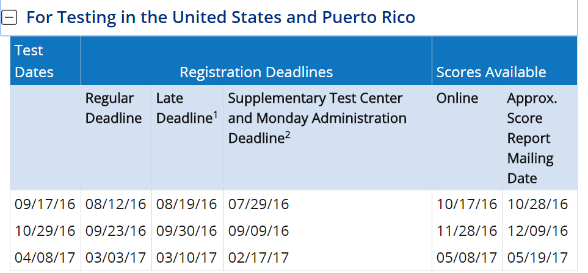
5b. Subject GRE
Biology/ Biochemistry / Chemistry/ Math/ Physics
https://www.ets.org/gre/subject/about/

Slide 12
6. Resume
One page
The skills you have (Relevant to labs)
Lab experience, work experience
Extra-curricular activities (ASBMB especially outreach!!!!)
Specific skills you have
Get it checked by career services
Amanda Stupakevich
amanda.stupakevich@umb.edu
CC 1300
617-287-5519
Notes:
relevant lab skills (pcr, titrations, elisa, gel electro, sds, western/southern blotting, chip, etc.)

Slide 13
7. Publications
If you work in a lab long enough, you can get published
BUT, it is not a disqualifying criterion
Should still apply!
If you do publish, make sure you upload a copy of your article for graduate programs to review

Slide 14
7. Poster Presentations
IMSD- https://www.umb.edu/academics/csm/biology/beyond_the_classroom/initiative_for_maximizing_student_development
REU- https://www.umb.edu/academics/csm/biology/beyond_the_classroom/research_experiences_for_undergraduates
McNair- https://www.umb.edu/academics/csm/student_success_center/beyond_the_classroom/mcnair
SACNAS- https://www.umb.edu/news/detail/umass_boston_hosts_society_for_chicanos_hispanics_and_native_americans_in_s
ASBMB regional/ national conference- https://www.asbmb.org/meeting2017/
Notes:
nice but not neccessary, but strongly encouraged
explain why - cuz it gives you an opp to showcase your work as well as shows grad schools you can talk about your research (v. imp)
you have to submit an abstract (something that is necessary to poster presentations - can be judged and/or not judged)

Slide 15
8a. Fellowships
U54- https://www.umb.edu/u54
Genzyme/oracle- https://forms.umb.edu/sgo-urf
BSSF-https://www.umb.edu/news_events_media/events/student_success_fellowship_fall_symposium

Slide 16
8b. Pre-doctoral Fellowships
Pre-doctoral fellowships are stipend grants for doctoral programs
NSF, Google’s Women Scholarship, Gates Millennium Scholars
Eg. NSF
Personal Statement
Research Strategy
Letter of support
Unofficial Transcript
Links:
https://www.nsfgrfp.org/applicants/application_components
https://www.womentechmakers.com/scholars
http://www.gmsp.org/scholar-portals/
Notes:
use journals to interest - there is usually a question waiting to be answered - so much we don't know

Slide 17
9. Applications
Open: Beginning of September
Get basic information out of the way when you have time
Close: First week of December
Bulk of work should get done in October/ November and the summer before!
Notes:
usually 1 december, or 15th of december (Each program is diff, some even jan)

Slide 18
10. Interviews
Some schools it means you got in!
Other schools actually treat it like an actual interview
All schools just want to see if you can talk about the research you do comfortably

Slide 19
11. Now What??

